Slide 1
A Novel approach for brain tumor prediction using Machine Learning Algorithm
PIP2001 Capstone Project
Review-0
Batch Number : COM-19
Roll Number | Student Name
20211COM0066 20211COM0085 | K.M.Madhushree Sakshi.S
20211COM0052 | Misbah Anum
20211COM0086 | Syeda Taskiya Fathima
20211COM0061 | Suhana Anjum
Under the Supervision of,
Dr./Mr./Ms./Assistant Prof. Mr. Arun Kumar S
Professor / Associate Professor / Assistant Professor
School of Computer Science and Engineering
Presidency University
Name of the Program: Computer Engineering
Name of the HoD: Dr.Gopal Krishna Shyam
Name of the Program Project Coordinator: Dr Sudha P(AP)
Name of the School Project Coordinators: Dr. Sampath A K / Dr. Abdul Khadar A / Mr. Md Ziaur Rahman

Slide 2
Content
Problem Statement
Analysis of Problem Statement
Timeline of the Project
References

Slide 3
Problem Statement Number:
Organization: Presidency University
Category (Hardware / Software / Both) :Software
Problem Description : Current brain tumor detection methods can be limited by subjective image analysis and variability in medical imaging. We propose a novel approach using support vector machine(SVM) algorithm to automatically and accurately predict brain tumors from scans and data provided with efficient net frameworks. This hybrid model aims to leverage SVMs for improved feature extraction and classification, enhancing diagnostic precision and early detection.
Difficulty Level: Moderate to high difficulty

Slide 4
Analysis of Problem Statement
Technology Stack Components:
1.Data Acquisition and Management : data storage and data sources
Cloud storage solutions or local storage systems for managing large volumes of imaging data.
2.Data Preprocessing: Libraries and tools
Python Libraries: NumPy, OpenCV, SciPy, PIL (Pillow) for image manipulation and preprocessing.
3. Model Development : Deep Learning Frameworks
PyTorch : Popular deep learning framework providing flexibility and control over the network design.
4. Training and Evaluation :
Evaluation Metrics: Tools and libraries for evaluating model performance, such as scikit-learn for metrics like
accuracy, precision, recall, F1-score, and confusion matrix.
5. Model Optimization:
Techniques for reducing model size and improving inference speed, like quantization and pruning.
6. Deployment : Deployment Platforms
API’s : RESTful Api’s for integrating the model with other application or healthcare systems.
Cloud Services: Google cloud functions for serverless deployment.

Slide 5
Analysis of Problem Statement (contd...)
Software Requirements:
1.Development environment:
programming language : python
2.Machine learning frameworks:
TensorFlow , PyTorch
3.Development tools:
Jupyter notebook, pycharm / visual studio code
4.Data security:
Encryption tools : using python libraries for securing data.
5.Version controls:
version control systems : Git , GitHub

Slide 6
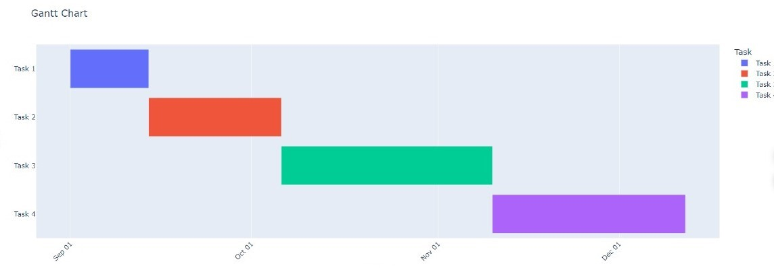
Timeline of the Project (Gantt Chart)
.

Slide 7
References (IEEE Paper format)
M.A. Naser, M.J. Deen, Brain tumor segmentation and grading of lower-grade glioma using deep learning in MRI images, Comput. Biol. Med. 121 (2020) 103758.
M. Naidu, P.R. Kumar, K. Chiranjeevi, Shannon and fuzzy entropy based evolutionary image thresholding for image segmentation, Alex. Eng. J. 57 (3) (2018) 1643–1655.
M.U. Rehman, S. Cho, J.H. Kim, K.T. Chong, Bu-net: Brain tumor segmentation using modified U-Net architecture, Electronics 9 (12) (2020) 2203.
L. Chen, Y. Wu, A.M. DSouza, A.Z. Abidin, A. Wismüller, C. Xu, MRI tumor segmentation with densely connected 3D CNN, in: Medical Imaging 2018: Image Processing. Vol. 10574, SPIE, 2018, pp. 357–364.

Slide 8
References (links)
https://ieeexplore.ieee.org/abstract/document/10101618
https://www.mdpi.com/2078-2489/15/8/489#:~:text=The%20fine%2Dtuned%20EfficientNet%2DB0%20model%20achieved%20an%20accuracy%20of,where%20accurate%20diagnosis%20is%20critical.

Slide 9


